Slide 1

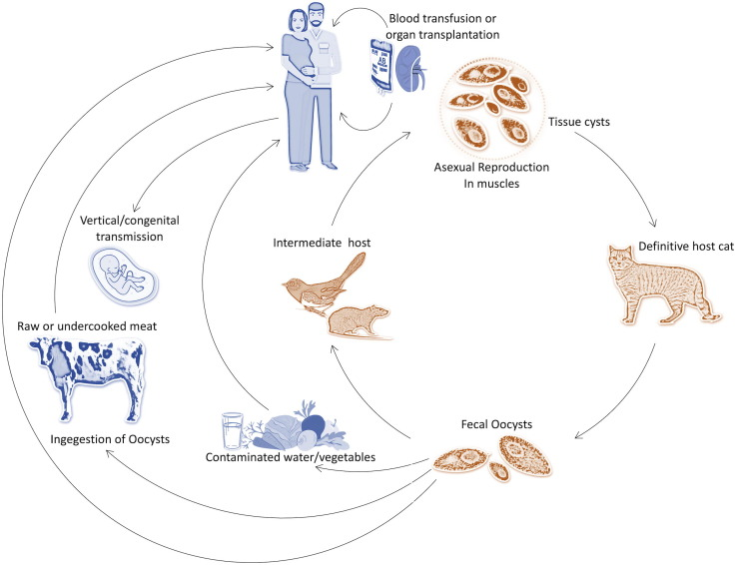
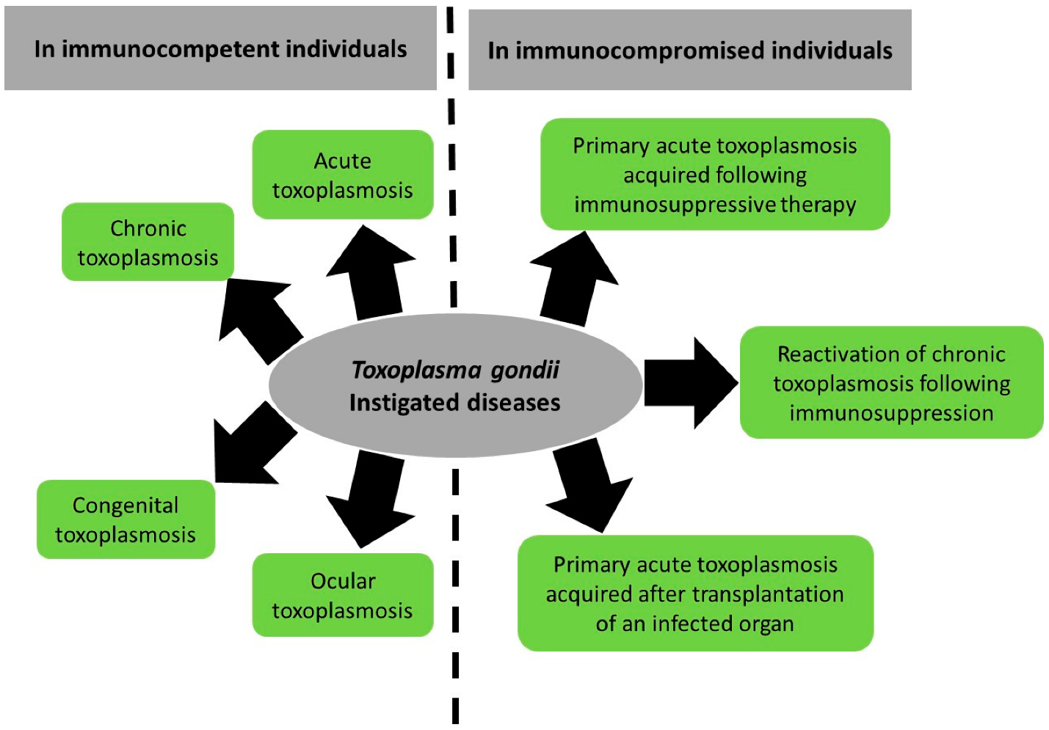
Pathogenesis and Therapeutic Aspect of Toxoplasma gondii Infection
Usifoh: Student Number:
ABSTRACT
PREVENTION
Toxoplasma gondii is the causative agent of toxoplasmosis, a widespread zoonotic infection affecting humans and animals. This poster provides a comprehensive overview of the pathogenesis of Toxoplasma gondii infection and discusses the current therapeutic strategies employed for its management. It outlines the life cycle and transmission routes of Toxoplasma gondii, the various stages of the parasite's life cycle, the immune response elicited by the host, and the strategies employed by the parasite to evade immune defenses. It also highlights the importance of prevention and control measures, such as hygiene practices, and the potential future directions in the treatment of Toxoplasma gondii infection.
Prevention efforts seek to lessen the likelihood that a person may get infected with Toxoplasma gondii. Some examples are:
Safe Food Handling: Tissue cysts in meat may be destroyed by cooking it to an internal temperature of at least 160 degrees Fahrenheit (71 degrees Celsius). Meat may also be rendered safe by freezing it at -4°F (-20°C) for at least 72 hours (Aleem et al., 2018).
Hygiene Standards: In order to stop the spread of T. gondii, it is important to thoroughly wash hands, utensils, and cutting boards after handling raw meat (Oyeyemi et al., 2020, WHO 2022).
Protection of Immune-compromised Individuals Pregnant women and others with compromised immune systems should take additional care to maintain clean living conditions (Al-Malki, 2021). They should be avoided from cleaning cat litter boxes due to their compromised immune system which made them predispose to the infection. It is suggested to use disposable gloves if needed and to properly wash hands afterward (Al-Malki, 2021).
Water Sources: It has been found that the drinking of cleanse portable water reduce your risk of illness.
INTRODUCTION
Toxoplasma gondii is an obligate intracellular protozoan parasite that infects a wide range of warm-blooded animals, including humans. It can have varying clinical manifestations depending on the host's immune status (Jones et al., 2003;Aleem et al., 2018). McLeod et al. (2014) stated that most people show no signs of infection, if left untreated it may cause severe illness (Oyeyemi et al., 2020). T. gondii infection is often asymptomatic in humans, but may cause a severe case of toxoplasmosis in certain people, especially babies and individuals with compromised immune systems (Oyeyemi et al., 2020). The pathogenesis of Toxoplasma gondii involves a complex interplay between the parasite and the host's immune system (Hide, 2016). Initially, innate immune cells recognize the presence of the parasite and initiate an inflammatory response. Toxoplasma gondii has evolved mechanisms to evade and manipulate the host immune response, allowing it to establish chronic infection (Aleem et al., 2018). As such Khadem et al. (2019) opined that treatment options include antiparasitic drugs, but drug resistance and limited efficacy against tissue cysts are areas of concern. Prenatal screening programs and management of infected pregnant women are needed to prevent congenital toxoplasmosis (Rostami I et al., 2020). This assessment presents the pathogenesis, prevention, treatment and emerging therapeutic for Toxoplasma gondii.
TREATMENT
Table 1: Evidence data on Drugs and dosages for Toxoplasma gondii
Author | Drug and Dosages | Efficacy and Safety Data
Shiojiri et al. 2019 | Azithromycin only, to trimethoprim/sulfamethoxazole, pyrimethamine, sulfadia- zine, and atovaquone, Combination of clindamycin and azithromycin | Azithromycin only, to trimethoprim/sulfamethoxazole, pyrimethamine, sulfadiazine, and atovaquone were not effective, but combination of clindamycin and azithromycin was effective
Habib et al. 2008 | Spiramycin=2g/day, for 14day administered to 19 pregnant women infected with Toxoplasma gondii | Efficacy: 8 patients recovered, while 11 patients remain positive
Chirgwin et al. 2001 | Toxoplasmic encephalitis (TE) in patients with human immunodeficiency virus infection is treated with atovaquone suspension (1500 mg orally twice daily) combined with either pyrimethamine (75 mg daily after a 200-mg loading dose) or sulfadiazine (1500 mg four times daily) as both an acute treatment (for 6 weeks) and a maintenance therapy (for 42 weeks). | Efficacy=Treatment for acute illness was effective in 21 (75%) of 28 patients who received pyrimethamine and in 9 (82%) of 11 patients who received sulfadiazine. Safety=Only 1 of the 20 patients in the maintenance period had a recurrence. Of the 40 eligible patients, 11 (28%) terminated therapy due to adverse events, 9 of them had nausea and vomiting or a taste sensitivity to the atovaquone suspension.
Torre et al. 1998 | Pyrimethamine- sulfadiazine= Pyrimethamine : 50 mg/d, sulfadiazine:60 mg/kg/d administrered to 58 AIDS patients with toxoplasmic encephalitis without pregnant, age over 18 years old | Efficacy: 23 patients were cured, while 35 patients remain positive
PATHOGENESIS
EMERGING THERAPIES
Toxoplasmosis is being studied for a number of potential new treatments and preventative measures, including:
Vaccines: Research on creating a vaccine that is both effective and safe against T. gondii is ongoing. Vaccination has the capacity to either completely avoid illness or significantly mitigate its effects (Chu & Quan, 2021).
New antiparasitic Drugs: In order to combat medication-resistant forms of toxoplasmosis, scientists are investigating potential novel antiparasitic chemicals and pharmacological combinations that might be used as either primary or supplementary therapies. Example of such are nanoparticles and liposomes based novel drug delivery technologies being researched to enhance the targeting and potency of antiparasitic medicines against T. gondii (Murphy et al., 2022; Wang et al., 2021).
Immunotherapies: Efforts are being made to improve the body's natural capacity to manage and eradicate T. gondii by investigating immunomodulatory techniques, such as increasing the immune response to the infection as has been show in Toxovax® that has been found effective in veterinary clinical practice, however effort are no the way to develop for use in humans (Bhadra et al 2011).
CONCLUSION
Toxoplasma gondii infection's pathogenesis and treatment options are thoroughly discussed in this poster. It also present more emerging treatment options and preventative measures by improving our knowledge of the intricate relationship between the parasite and the host. The approved therapeutic found in literature that were efficacious and safe were azithromycin, spiramycin, pyrimethamine- sulfadiazine and atovaquone. The important of hygiene and food safety was discussed as necessary preventive measure.
Figure 1: Toxoplasma gondii Transmission Circle (Al-Malki, 2021).
This figure present the pathogenesis of Toxoplasma gondii and the transmission mechanism
REFERENCES
-Aleem, U., Ullah, S., Qasim, M., & Suliman, M. (2018). Seroprevalence of Toxoplasmosis in Pregnant Women in Matta , Upper Swat , Khyber Pakhtunkhwa , Pakistan. Journal Of Saidu Medical College, 103–106. http://www.jsmc.pk/index.php/jsmc/article/view/88/55
-Al-Malki, E. (2021). Toxoplasmosis: stages of the protozoan life cycle and risk assessment in humans and animals for an enhanced awareness and an improved socio-economic status. Saudi Journal of Biological Sciences, 28(1), 962–969. https://doi.org/10.1016/J.SJBS.2020.11.007
-Bhadra, R., Gigley, J. P., & Khan, I. A. (2011). The CD8 T-cell road to immunotherapy of toxoplasmosis. Immunotherapy, 3(6), 789. https://doi.org/10.2217/IMT.11.68
-Chirgwin, K., Hafner, R., Leport, C., Remington, J., Andersen, J., Bosler, E. M., Roque, C., Rajicic, N., Mc Auliffe, V., Morlat, P., Jayaweera, D. T., Vilde, J. L., Luft, B. J., Sicard, D., Jeantils, V., Dupont, B., Raffi, F., Eid, Z., Dormant, J., … Notario, G. (2002). Randomized phase II trial of atovaquone with pyrimethamine or sulfadiazine for treatment of toxoplasmic encephalitis in patients with acquired immunodeficiency syndrome: ACTG 237/ANRS 039 study. Clinical Infectious Diseases, 34(9), 1243–1250. https://doi.org/10.1086/339551
-Chu, K. B., & Quan, F. S. (2021). Advances in Toxoplasma gondii Vaccines: Current Strategies and Challenges for Vaccine Development. Vaccines, 9(5). https://doi.org/10.3390/VACCINES9050413
-Habib, F. A. (2008). Post-treatment assessment of acute Toxoplasma infection during pregnancy. Journal of Obstetrics and Gynaecology, 28(6), 593–595. https://doi.org/10.1080/01443610802344332
-Hide, G. (2016). Role of vertical transmission of Toxoplasma gondii in prevalence of infection. Expert Review of Anti-Infective Therapy, 14(3), 335–344. https://doi.org/10.1586/14787210.2016.1146131
Jones, J., Lopez, A., & Wilson, M. (2003). Congenital Toxoplasmosis. American Family Physician, 67(10), 2131–2138. https://www.aafp.org/pubs/afp/issues/2003/0515/p2131.html
-Khademi, S. Z., Ghaffarifar, F., Dalimi, A., Davoodian, P., & Abdoli, A. (2019). Prevalence and Risk Factors of Toxoplasma gondii Infection among Pregnant Women in Hormozgan Province, South of Iran. Iranian Journal of Parasitology, 14(1), 167. https://doi.org/10.18502/ijpa.v14i1.732
-McLeod, R., Lykins, J., Gwendolyn Noble, A., Rabiah, P., Swisher, C. N., Heydemann, P. T., McLone, D., Frim, D., Withers, S., Clouser, F., & Boyer, K. (2014). Management of Congenital Toxoplasmosis. Current Pediatrics Reports, 2(3), 166–194. https://doi.org/10.1007/s40124-014-0055-7
-Murphy, R. D., Chen, T., Lin, J., He, R., Wu, L., Pearson, C. R., Sharma, S., Vander Kooi, C. D., Sinai, A. P., Zhang, Z. Y., Vander Kooi, C. W., & Gentry, M. S. (2022). The Toxoplasma glucan phosphatase TgLaforin utilizes a distinct functional mechanism that can be exploited by therapeutic inhibitors. Journal of Biological Chemistry, 298(7), 1–17. https://doi.org/10.1016/j.jbc.2022.102089
-Oyeyemi, O. T., Oyeyemi, I. T., Adesina, I. A., Tiamiyu, A. M., Oluwafemi, Y. D., Nwuba, R. I., & Grenfell, R. F. Q. (2020). Toxoplasmosis in pregnancy: a neglected bane but a serious threat in Nigeria. Parasitology, 147(2), 127–134. https://doi.org/10.1017/S0031182019001525
-Periz, J., Whitelaw, J., Harding, C., Gras, S., Minina, M. I. D. R., Latorre-Barragan, F., Lemgruber, L., Reimer, M. A., Insall, R., Heaslip, A., & Meissner, M. (2017). Toxoplasma gondii F-actin forms an extensive filamentous network required for material exchange and parasite maturation. ELife, 6, 1–29. https://doi.org/10.7554/eLife.24119
-Rostami, A., Riahi, S. M., Gamble, H. R., Fakhri, Y., Nourollahpour Shiadeh, M., Danesh, M., Behniafar, H., Paktinat, S., Foroutan, M., Mokdad, A. H., Hotez, P. J., & Gasser, R. B. (2020). Global prevalence of latent toxoplasmosis in pregnant women: a systematic review and meta-analysis. Clinical Microbiology and Infection, 26(6), 673–683. https://doi.org/10.1016/j.cmi.2020.01.008
-Shiojiri, D., Kinai, E., Teruya, K., Kikuchi, Y., & Oka, S. (2019). Combination of clindamycin and azithromycin as alternative treatment for toxoplasma gondii encephalitis. Emerging Infectious Diseases, 25(4), 841–843. https://doi.org/10.3201/eid2504.181689
-Torre, D., Casari, S., Speranza, F., Donisi, A., Gregis, G., Poggio, A., Ranieri, S., Orani, A., Angarano, G., Chiodo, F., Fiori, G., & Carosi, G. (1998). Randomized trial of trimethoprim-sulfamethoxazole versus pyrimethamine- sulfadiazine for therapy of toxoplasmic encephalitis in patients with AIDS. Antimicrobial Agents and Chemotherapy, 42(6), 1346–1349. https://doi.org/10.1128/aac.42.6.1346
-Wang, D., Xing, M., El-Ashram, S., DIng, Y., Zhang, X., Sang, X., Feng, Y., Chen, R., Wang, X., Jiang, N., Chen, Q., & Yang, N. (2021). Determination of lumefantrine as an effective drug against Toxoplasma gondii infection – in vitro and in vivo study. Parasitology, 148(1), 122–128. https://doi.org/10.1017/S0031182020002036

